Slide 1
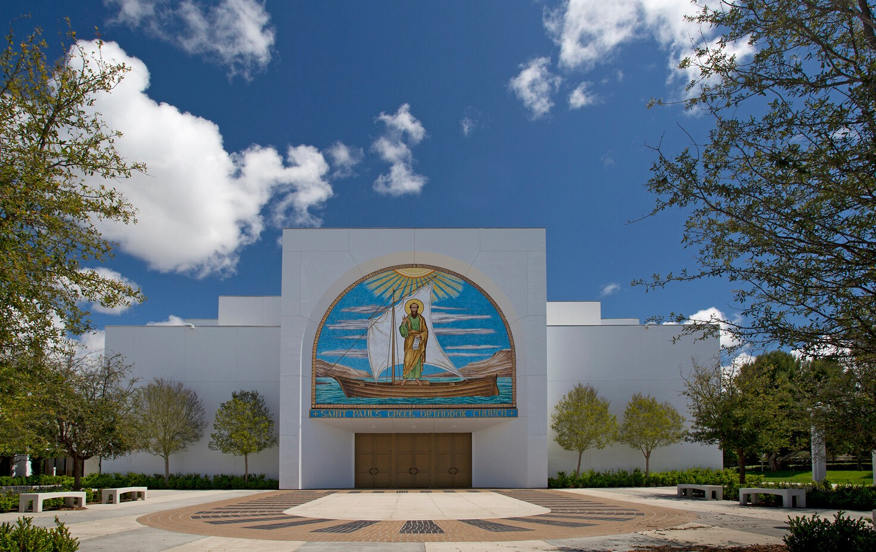
St. Paul's Greek Orthodox Church
The Journey Home
Re-opening St. Paul's for Worship
"Make Love Your Aim" - 1 Corinthians 14:1
USHER EDITION
June 2020

Slide 2

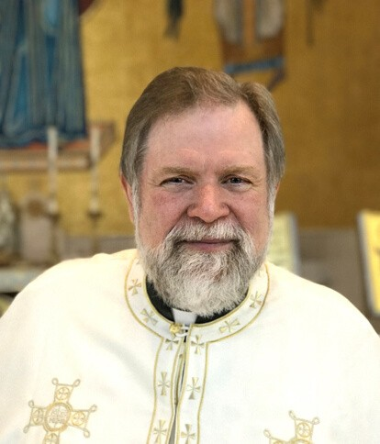
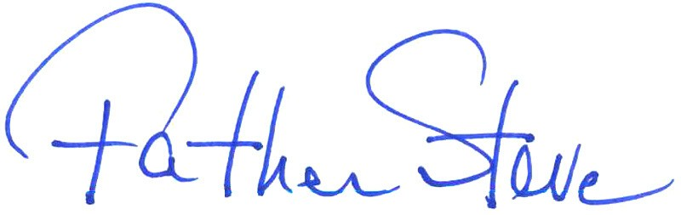
"You have need of patience,
so that by doing the will of God you will receive what is promised."
Hebrews 10:36
Brothers and Sisters in Christ, members of our St. Paul's family,
Thank you all for your words of support for one another, your generosity, acts of kindness and the love you’ve shared with one another over these past several months. Most of all, thank you for your patience as we pass through these uncertain times as the Body of Christ, His Church, the Temple of the Holy Spirit.
The question on everyone’s mind is - when we will open St. Paul’s for worship once again? With the blessing of our bishop, Metropolitan Gerasimos, and in consultation with the local health authorities, we will open our Church for
the public celebration of the Liturgy on Sunday, June 28th.
Metropolitan Gerasimos has provided guidelines and directives as to how best to proceed. Our Parish Staff and Parish Council have already begun readying the Church for communal worship once again. We are preparing what is needed to open our Church with all the necessary safety precautions in place.
The opening of St. Paul’s for communal worship will be done in phases. Initially, for example, we will need to register online (or by calling the parish office) to attend services. Attendance is limited to no more than 100 people within the sanctuary because of the need to follow social distancing guidelines. The Parish Event Center will also be open to accommodate another 100 people, with Liturgy live-streamed into the Center (clergy will come to the Center to offer Holy Communion to the faithful gathered there). Seating will also be available in the plaza and if necessary, we will also use the Parish Hall. Please note that the wearing of masks is required. Certain liturgical practices like the kissing of icons and the Gospel Book must be temporarily modified. These are not permanent changes to the ancient practices of our Church, but are temporary measures put in place to better ensure our safety at this time.
For those unable to attend Liturgy, the live-streaming of our services will continue.
Let me ask for your continued patience as we continue to navigate these uncharted waters together. Please read this booklet carefully. It is meant to provide a guide for you as we gather for worship under these new, but temporary, circumstances.
With love in Christ,
St. Paul's Greek Orthodox Church | Irvine, CA

Slide 3

WORSHIP GUIDELINES
What to Expect
LIMITED ATTENDANCE
At the present time, seating in our sanctuary is limited to 100 people by the State of California and local health department regulations on social gatherings. St. Paul's will seek to maximize worship opportunities for everyone through:
advance reservations
additional seating areas in the Event Center and the Parish Hall
extra services (during the week)
live-stream services can be found at www.stpaulsirvine.org
SOCIAL DISTANCING
Designated seating areas will be clearly marked to abide by current social distancing guidelines requiring at least six feet between families. Ushers will guide you to your seats. You may not be able to sit where you normally have in the past.
HEALTH SAFETY MEASURES
Please follow the signs and floor markings that provide specific directions in maintaining social distancing. Stations will be available to sanitize your hands. Face masks are required. There will be no Liturgy books, Sunday bulletins or other printed materials available.
PURCHASING CANDLES
In an effort to minimize the handling and exchanging of currency in the Narthex, please consider either purchasing your candles online from our website or by preparing your candle offering in an envelope to be brought to church and deposited in the candle tray in the Narthex.
HOLY COMMUNION
Orthodox Christians believe that in receiving Holy Communion we are receiving the Body and Blood of Jesus Christ. The Body and Blood of Jesus Christ is not a vehicle for the transmission of disease. We will distribute Holy Communion by asking you to receive with an open mouth, head tilted back.
WORSHIP ADJUSTMENTS
Instead of kissing, you are asked to reverence icons and other sacred objects by bowing. Please greet one another by bowing instead of embracing or shaking hands. Father Steve will not be able to bless the children. Please do not kiss the priest's hand.
St. Paul's Greek Orthodox Church | Irvine, CA

Slide 4
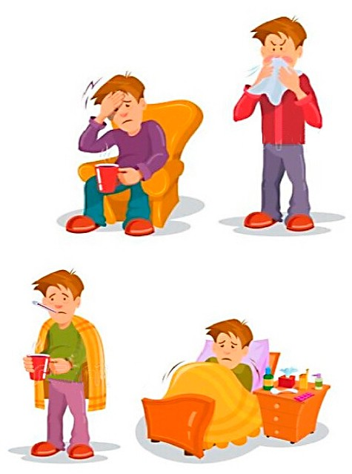

WORSHIP GUIDELINES
Before Attending
What you are asked to do and understand before you arrive
ATTENDANCE RECOMMENDATIONS
Those with any signs or symptoms of any acute illness (whether it
is COVID-19 or not) MUST stay home, as should those who have come into contact with COVID-19. It is strongly recommended that parishioners who are 65 or older, especially those living in long-term care facilities and who suffer from serious medical conditions such as cardiac and/or pulmonary disease, diabetes, a compromised immune system, or other underlying health issues, participate in live-streamed services from home at this time. Questions should be directed to your healthcare provider.
RESERVATIONS REQUIRED
At the present time, seating in our sanctuary is limited to 100 people by the State of California and local health department regulations on social gatherings. Additional seating in the Event Center and Parish Hall will also be made available. Reservations are necessary to accommodate the limited number of worshipers we are allowed in a fair manner. Online and phone-in reservations will be required of those desiring to attend. Those arriving at church without a reservation may be turned away if there are no available seats.
PREPARE FOR OFFERINGS IN ADVANCE
To minimize the handling and exchanging of currency in the
church, please consider either making your stewardship, other donations, and candle purchases through electronic giving or by preparing your offering in an envelope to be brought to church and deposited in one of the trays in the Narthex or as you exit the church after Liturgy. You may also mail your offering to the Church Office. Trays will not be passed during the service.
WHAT YOU AGREE TO BY ATTENDING
By voluntarily entering St. Paul's campus, you affirm that you are not currently ill or
experiencing COVID-19 symptoms; you agree to abide by the safety guidelines being practiced at St. Paul's including wearing a face mask and observing social distancing; you acknowledge that while safety measures are being taken by the church, it cannot guarantee the safety of every person present. You further acknowledge, that while the recommended CDC, State and Local County safety measures are being taken by the Church, the parish cannot guarantee that there is no risk of infection for attendees. If you are not able to agree to and affirm the above statements, we ask that you remain at home to participate in the live-streaming services.
St. Paul's Greek Orthodox Church | Irvine, CA

Slide 5

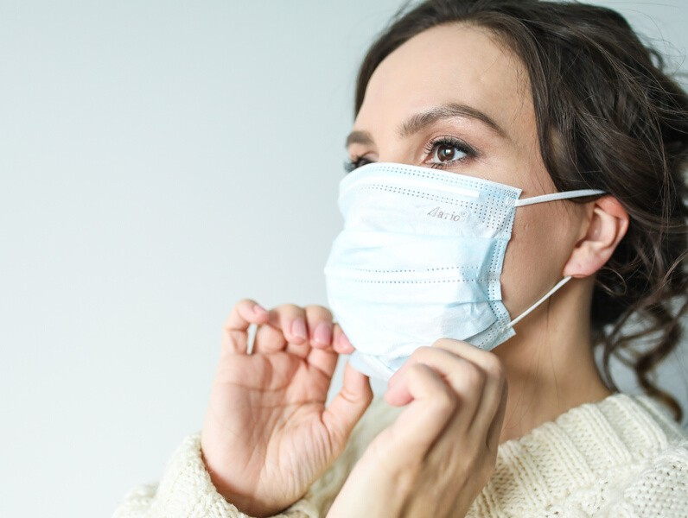

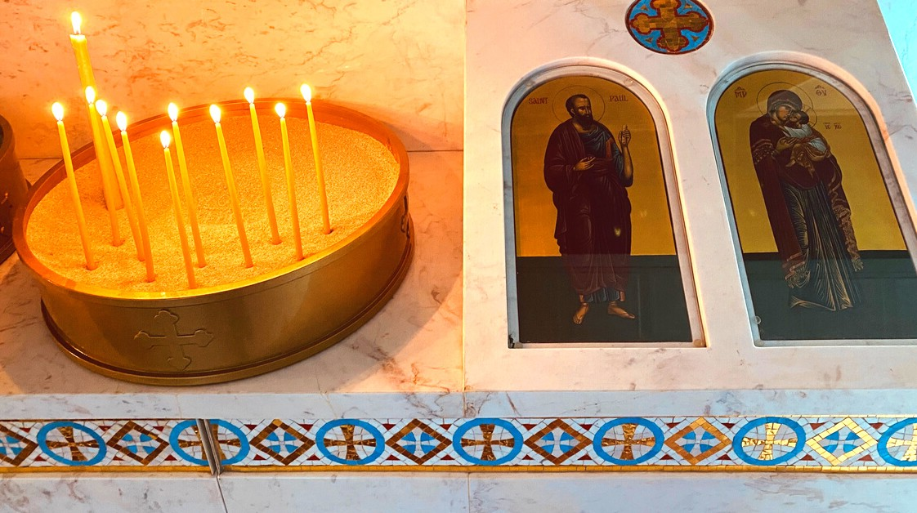
WORSHIP GUIDELINES
During Services
What you are asked to do as you attend worship services
ON-TIME ARRIVAL
You will need to check in upon arrival at St. Paul's and you'll need to be guided to a seating area, it is most helpful and appreciated for you to arrive no later than 9:30 am -- 30 minutes before the Liturgy begins at 10 am.
FACE MASKS REQUIRED
For the health and safety of our community, all attendees will
be required to wear protective face masks. Only children under the age of 2 should not wear masks. If you do not have a face mask, one will be provided.
FOLLOW THE SIGNS
Please follow posted signs at entry points, aisles, and designated
seating areas. These have been prepared in advance to provide safe social distancing and need to be respected for everyone's well-being. Additional signage will indicated other safety guidelines and expectations.
SOCIAL DISTANCING IN SEATING AREAS
Designated seating areas will allow for spacing between
individuals and families. Members of the same household may be seated in the same area without social distance between them. Everyone is required to remain in their seating area throughout the service except for receiving Holy Communion.
WORSHIP ADJUSTMENTS
Instead of kissing icons, you are asked to reverence icons and other sacred objects by bowing. Please greet one another by bowing instead of embracing or shaking hands. Father Steve will not be able to bless the children. Please do not kiss the priest's hand.
St. Paul's Greek Orthodox Church | Irvine, CA

Slide 6
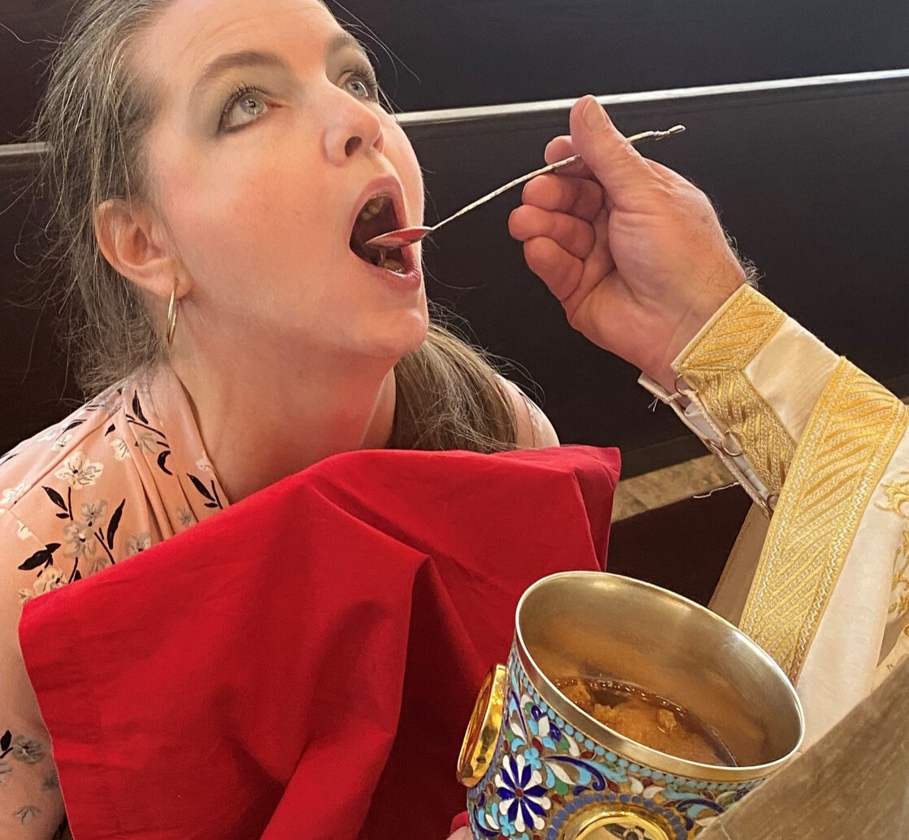
WORSHIP GUIDELINES
During Services
What you are asked to do as you attend worship services
HOW TO RECEIVE HOLY COMMUNION
Orthodox Christians believe that in receiving Holy Communion we are receiving the Body and Blood of Jesus Christ. The Body and Blood of Jesus Christ is not a vehicle for the transmission of disease. However, with pastoral sensitivity and love toward all parishioners during this unique time, we will distribute Holy Communion in the following manner:
St. Paul's Greek Orthodox Church | Irvine, CA
Please remove your face mask prior to arriving at the Holy Chalice.
When receiving, open your mouth fully and tilt your head back so the priest may place the Communion spoon in your mouth and turn it over to allow the Holy Gifts to drop in your mouth. Please do not close your lips on the spoon.
Please do not touch the Communion cloth or dab your lips on it. There is no need, since your lips have not touched the Holy Gifts. It will be held by the altar attendants to protect against spills.
After receiving Holy Communion but before replacing your mask, proceed to the Antidoron tray to take a piece of blessed bread and consume it before putting on your mask again. Then, please wear your face mask for the remainder of the service.

Slide 7
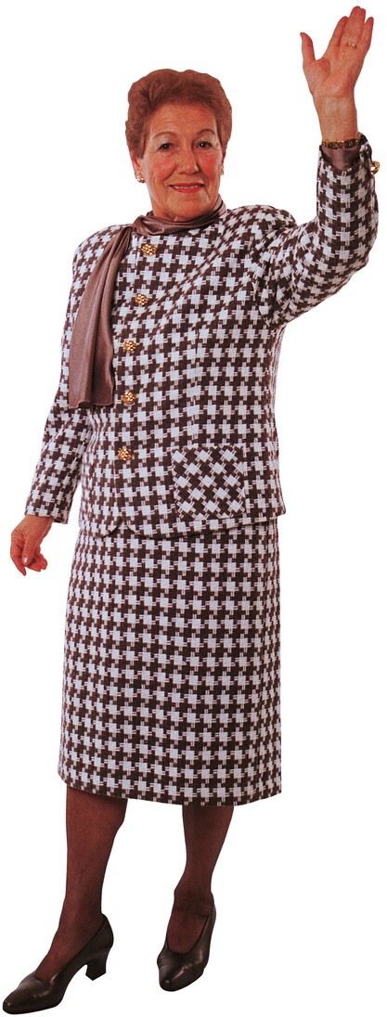
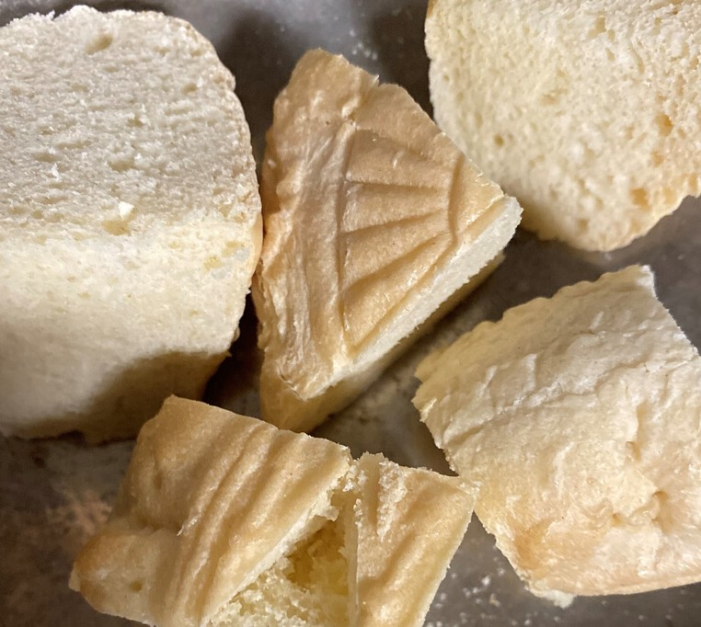
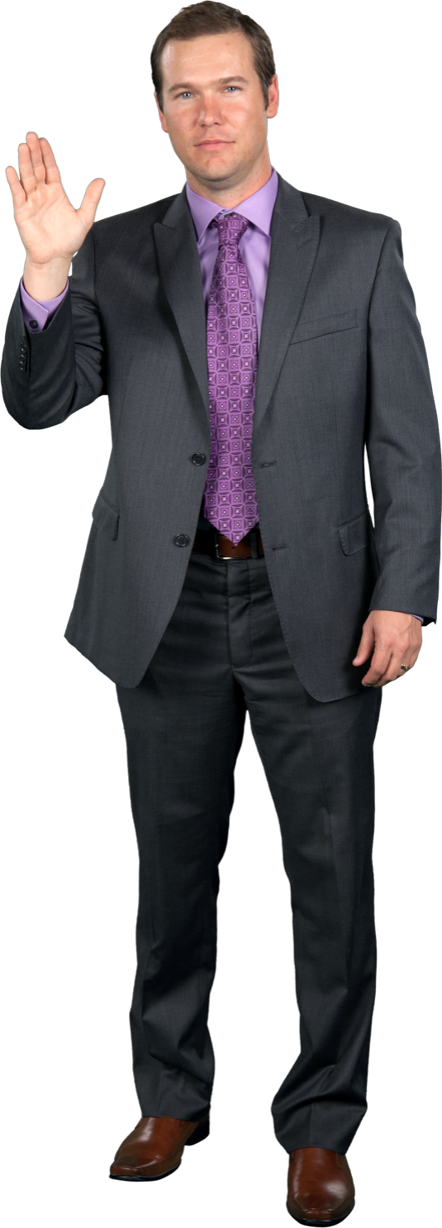
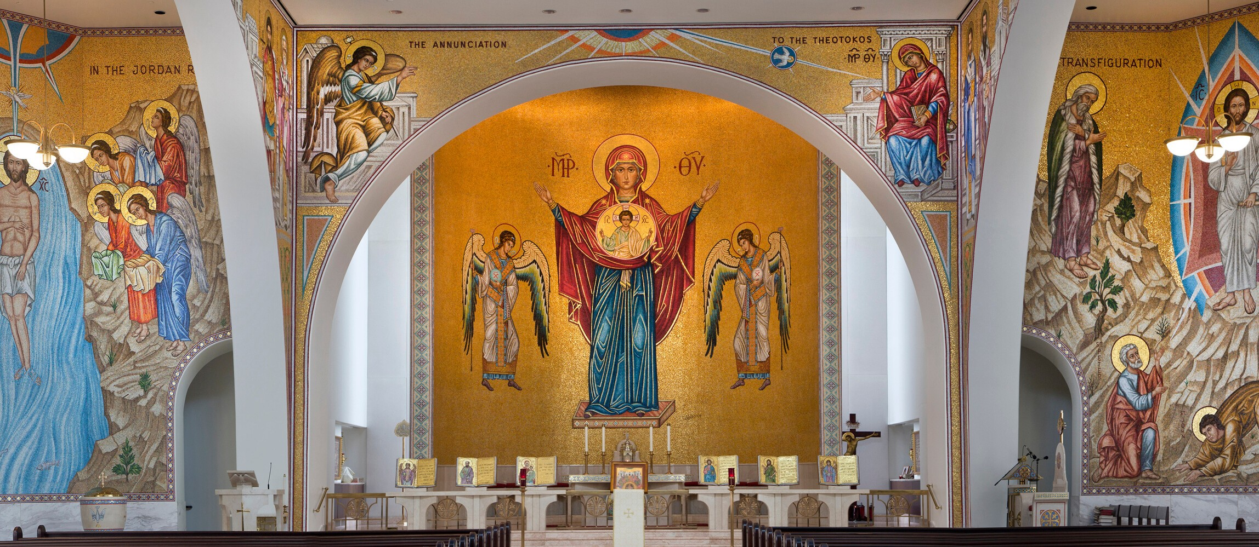
WORSHIP GUIDELINES
After Services
What you are to do and understand after worship services
MAINTAIN SOCIAL PHYSICAL DISTANCE ON EXITING
Please follow the directions provided by the priest and the guidance of any ushers regarding exiting with social distance.
ANTIDORON IS AVAILABLE ON EXIT
Antidoron (or blessed bread) will be available for
you to take from a tray located at the exit point from the service.
PLEASE DEPART IMMEDIATELY FOLLOWING THE SERVICE
Much as this goes against our common practice following services,
please do not congregate anywhere on the church property. All in attendance are asked to leave the premises immediately following the conclusion of the Liturgy.
NO COFFEE HOURS
Coffee hours, lunches, and other social gatherings will not be held at the parish during this initial phase of re-opening. Please understand we will return as soon as possible when restrictions are loosened.
St. Paul's Greek Orthodox Church | Irvine, CA
Welcome Home

Slide 8
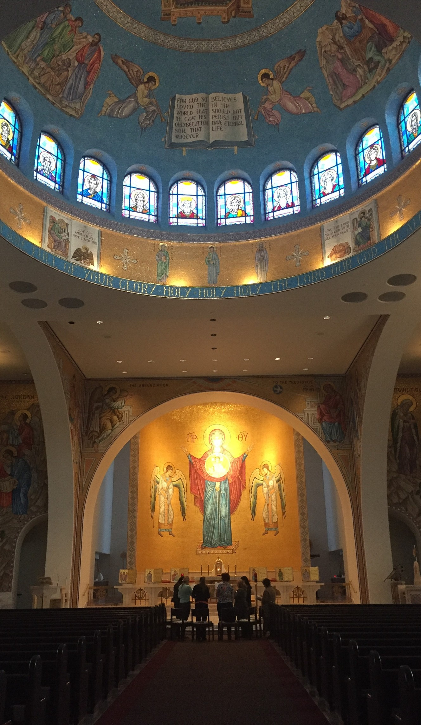
Blessed are those who persevere under trial because, having stood the test, they will receive the crown of life that the Lord has promised to those who love Him.
JAMES 1:12
St. Paul's Greek Orthodox Church | Irvine, CA
Thank you for your patience and perseverance during these uncertain times.

Slide 9
USHER SUPPLEMENT
This special supplement has been designed to help prepare and guide our ushers as we strive to create a safe and welcoming environment for our parishioners.
It contains specific guidelines regarding:
Your Responsibilities
Layout & Flows & Usher Positioning
Safety Precautions
Handling Delicate Situations
St. Paul's Greek Orthodox Church | Irvine, CA
INTRODUCTION

Slide 10
ENSURING
SAFETY AND SUPPORT
Communicate cheerful, friendly, and welcoming atmosphere
Ensure the safety of parishioners, staff and clergy by actively maintaining proper social distancing, mask wearing and hand sanitizing.
Demonstrate patience and understanding when parishioners are frustrated or upset with changes.
Effectively communicate and enforce safety measures required by local and state authorities and the Metropolis of San Francisco.
Please note: Ushers will not be responsible for the cleaning and sanitizing of the narthex, church or restrooms. Only trained personnel will perform this function.
St. Paul's Greek Orthodox Church | Irvine, CA
USHER RESPONSIBILITES

Slide 11
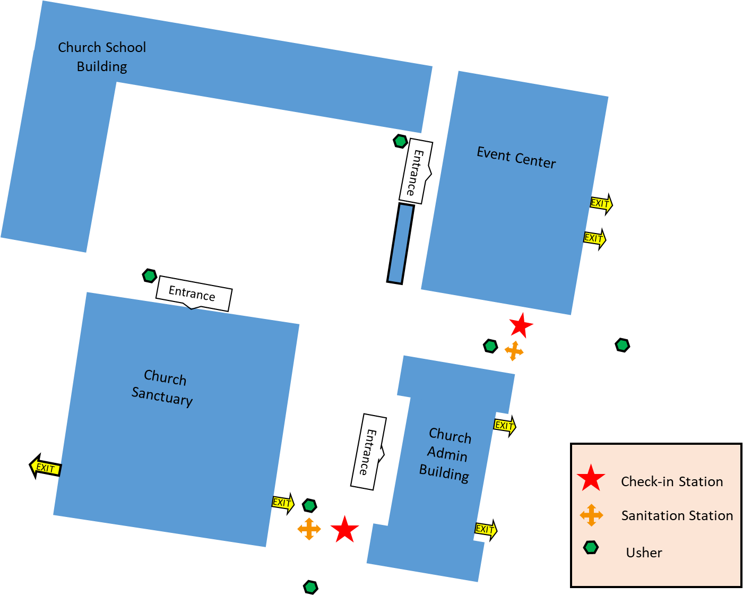
LAYOUT & FLOW
Check-In
St. Paul's Greek Orthodox Church | Irvine, CA
KEY GUIDELINES
Smile and welcome people back! Masks cover your face but not your eyes!
Ensure social distancing at all times.
Should someone arrive without a mask, offer them one. Masks must be worn at all times.
All must use hand sanitizer before leaving check-in.
Reservation lists, with building assignments, will be generated prior to Liturgy; parishioner assignments will be verified at check-in and they will be directed to the appropriate building.
CHECK-IN LAYOUT

Slide 12
USHER POSITIONING
Check-In & Parking Lot
4 Positions
PARKING LOT– 2 Total
One each stationed in East and North lots
Wear Masks and model social distancing.
Greet, welcome and be friendly.
Direct to the nearest Check-in Station.
Direct to read signage, follow arrows and social distancing markers on ground.
Encourage to wear face masks (if not wearing).
At 10:30 AM, open both Sanctuary rear side doors and post inside doors. 1 usher to each door. Do not allow entrance from outside in.
At Dismissal, stand outside the doors, greet folks as they exit and direct to the parking lot, so no one goes to the plaza or office areas.
CHECK-IN – 2 Total
Behind table with supplies. Greet, welcome, be friendly.
Pass out Face Masks, gloves as needed. Hand sanitizer.
Direct parishioners to front of church. Manage flow.
At 10:30 AM, open both Sanctuary front side doors and post inside doors. 1 usher to each door. Do not allow entrance from outside in.
St. Paul's Greek Orthodox Church | Irvine, CA
CHECK-IN & PARKING LOT

Slide 13
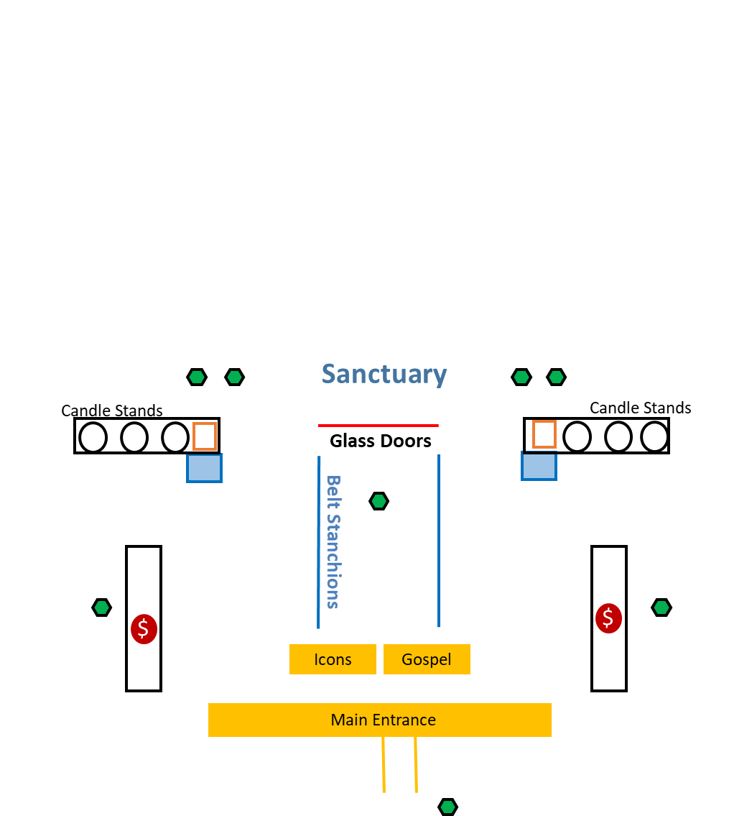
LAYOUT & FLOW
Narthex
St. Paul's Greek Orthodox Church | Irvine, CA
KEY GUIDELINES
Ushers in the narthex and check-in area must work in a coordinated fashion to monitor social distancing and slow the check-in line to avoid “line bunching” as parishioners await their seats within the church.
A gloved usher should hold or prop entrance door; parishioner should not touch handle.
Cash offerings, unless provided in an envelope, will not be accepted for candles; candles will be provided at no charge if cash, not sealed in an envelope, is offered
Unlit candles will be pre-positioned in the sand boxes prior to service; parishioners can light the candle and place it in the sand themselves.
Large candles, or red votive candles, will be handled by ushers.
The “cry room” will be used only as a diaper changing area.
The hallway door leading to the restrooms must remain open.
Should a parishioner kiss an icon, the surface must immediately be sanitized.
NARTHEX FLOW

Slide 14
USHER POSITIONING
Narthex
4 Positions
OUTSIDE CHURCH FRONT DOORS – 1 Total
Greet, welcome, be friendly.
Manage the flow into Narthex…alternate right, left to each side.
Allow entry of 1 individual, couple or family at a time. 50/50 each side.
As Candle tray area on each side is vacated, allow the next couple/family.
Leave doors open and remain outside for entire service.
BEHIND EACH CANDLE COUNTER – 2 Total
Greet, welcome, be friendly. Answer questions in quiet voice.
Light Sanctuary candles as requested.
Do not give change. No money handling.
Encourage parishioners with no cash to light Offering candles.
Remain in positions entire service.
IN FRONT OF CENTER GLASS DOORS – 1 Total
Manage flow into the Sanctuary. Minimize bottlenecks.
Release 1 couple or family at a time to ushers in Sanctuary.
Welcome, be friendly. Answer questions in quiet voice.
This Usher will dismiss for Communion in center isle, both sides.
This Usher will dismiss for dismissal (can switch with another).
St. Paul's Greek Orthodox Church | Irvine, CA
NARTHEX

Slide 15




LAYOUT & FLOW
Sanctuary
Solea
EXIT
EXIT
St. Paul's Greek Orthodox Church | Irvine, CA
PEWS
PEWS
Exit Side Doors after Liturgy
Return to Seat after Communion
Narthex
KEY GUIDELINES
Markers will be used to guide all traffic flow and ensure proper distancing.
Seating will be every other pew within designated rows only.
Immediate families from same household may sit together.
Ushers will guide parishioner(s) to their seat.
Parishioners may be seated in an area they don’t normally sit.
If parishioner needs to leave during Liturgy, the usher may need to empty the row.
At the close of Liturgy, exit using the side, front doors.
Communion, and the end of Liturgy dismissals, will begin from the front pews, as normal.
Approach for communion using the center aisle; ushers will release only one row at time to ensure proper distancing.
After receiving communion, parishioners return to seats via outside aisle.
SANCTUARY FLOW

Slide 16
USHER POSITIONING
Sanctuary
6 Positions
INSIDE GLASS DOORS – 4 TOTAL
2 Ushers for each side of Sanctuary to seat parishioners.
Wear Mask and model social distancing. Be friendly.
Escort to pews, one at a time (single, couple, or family).
Place in and explain designated areas within each pew.
Start from front of Sanctuary and place to the back.
Effectively manage special requests for seating, keep to a minimum.
After seating is completed, post inside glass and side doors.
At dismissal, stand next to offering tray, say good-bye as folks exit.
FRONT SIDE DOORS – 2 TOTAL
1 Usher on each side on edge of carpet, in front of door.
Face the congregation, look for attendees in distress/need.
Wear mask and model social distancing. Be friendly.
Monitor for those who may remove their face masks.
If face Mask is removed, approach and hand “Are You Ok” card.
Escort outside doors if they request fresh air.
Water is in the Narthex behind candle counter/usher closet.
At Communion and dismissal, stand next to tray of antidoron, on the Solea side of tray.
St. Paul's Greek Orthodox Church | Irvine, CA
SANCTUARY

Slide 17
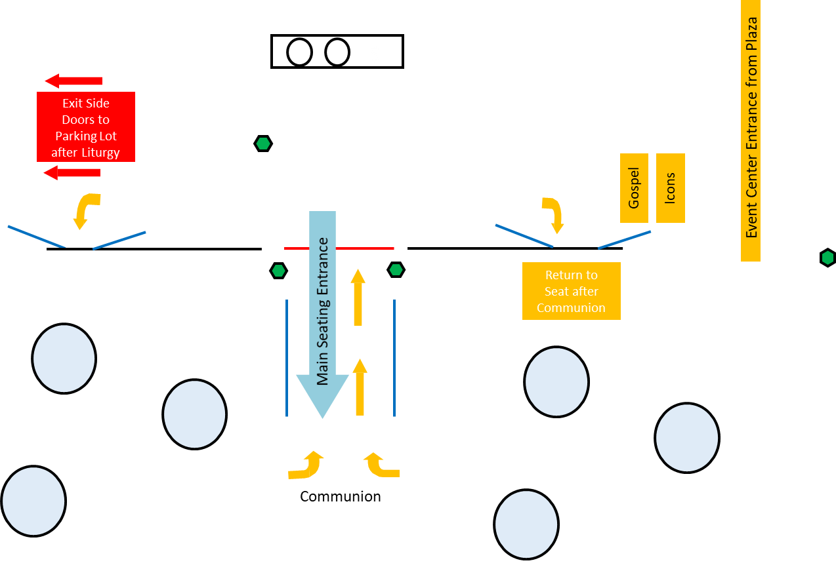
LAYOUT & FLOW
Parish Event Center
$
Main Hallway
St. Paul's Greek Orthodox Church | Irvine, CA
Ballroom
PARISH EVENT CENTER FLOW
KEY GUIDELINES
The Liturgy will be live-streamed directly into the Ballroom of the Parish Event Center.
Communion will be offered in the Parish Event Center, parishioners will remain to receive.
A narthex, with Icons and a Candle Stand will be set up in the main hallway – procedures will be consistent with those in the narthex of the Sanctuary.
Ushers will guide parishioners to seating areas.
Tables will be set-up to help ensure proper social distancing. As such, tables will not have to skipped or remain empty, all table areas can be used, but cannot be moved.
When exiting, parishioners should exit using the north doors off the main hallway, into the parking lot and not the plaza.

Slide 18
USHER POSITIONING
Parish Event Center
4 Positions
OUTSIDE ENTRY DOORS – 1 TOTAL
Greet, welcome, be friendly. Quietly answer questions.
Manage the flow into EC Hallway, which becomes Narthex.
Allow entry of 1 couple or family at a time.
As Icon-Candle area is vacated, allow the next couple/family.
Leave doors open and remain outside for entire service.
HALLWAY-NARTHEX – 1 TOTAL
Manage flow to Icon-Candle station, then into the Ballroom.
Release 1 couple or family at a time to ushers in Ballroom.
Welcome, be friendly. Answer questions in quiet voice.
This Usher will remain in hallway/narthex the entire service.
At dismissal, exit everyone out the North doors to the parking lot only.
Use Stanchions to block South doors to Plaza.
INSIDE BALLROOM – 2 TOTAL
1 Usher for each side of Ballroom to seat parishioners.
Wear Mask and model social distancing. Be friendly.
Escort to tables, one at a time (single, couple, or family).
Return to entry doors to place next attendee.
Start from front of Ballroom and place to the back.
Effectively manage special requests for seating, keep to a minimum.
These 2 ushers dismiss for Communion.
Communion dismissal up center isle. Return to seats through side doors.
These 2 ushers dismiss the dismissal.
St. Paul's Greek Orthodox Church | Irvine, CA
PARISH EVENT CENTER

Slide 19
KEY Safety Points
Please pray for the health and safety of all who are joining us today.
Our safety guidelines have been designed to comply those of the CDC, the State of California, Orange County Health Department, the City of Irvine and the Metropolis of San Francisco.
Masks must be worn at all times. Should someone have a medical condition preventing them from wearing a mask, they should be encouraged to return home and participate in the live-streaming of the Liturgy. However, per recent California state guidelines, the following exceptions do apply:
  Persons age two years or under.
  Persons with a medical condition, mental health condition, or disability that prevents wearing a face covering. This includes persons with a medical condition for whom wearing a face covering could obstruct breathing or who are unconscious, incapacitated, or otherwise unable to remove a face covering without assistance.
  Persons who are hearing impaired, or communicating with a person who is hearing impaired, where the ability to see the mouth is essential for communication.
All parishioners must check-in at the screening table; all ushers and alter servers must be checked-in prior to serving.
Facility cleaning will be completed by trained staff and not by ushers.
We are “cashless” – only electronic offerings or monies in a sealed envelope can be accepted.
Ushers should wash/sanitize their hands frequently.
If you see a parishioner who looks ill or is exhibiting COVID-like symptoms, do the following:
  Have them put on a mask immediately, if not wearing one.
  Ask them to step away from the crowd.
  Maintain your own social distancing.
  Ask them if they are feeling well today and if they have been in contact with anyone with COVID-like symptoms.
  Take their temperature; if over 100.3, they must leave.
  Ask them if they need medical attention at this time.
  If not, ask them to return home and participate in live-streaming of the Liturgy.
St. Paul's Greek Orthodox Church | Irvine, CA
SAFETY POINTS

Slide 20
HANDLING
DELICATE SITUATIONS
PERSON REFUSES TO WEAR A FACE MASK AT CHECK-IN
Should this occur, the individual will not be allowed to participate in our liturgy and enter the Parish Event Center or the Church. They will be asked to leave until such a time as they can comply with all health order and guidelines set by the Metropolis of San Francisco and our parish.
St. Paul's Greek Orthodox Church | Irvine, CA
PERSON TAKES THEIR FACE MASK OFF
Should this occur, with compassion, approach the individual and either ask them if they are ok or hand them a reminder card designed for this purpose. Utilize the special “Are You OK? Card by handing it to the person. Remember, if the person is hearing impaired, they may not be able to hear you behind your mask or read your lips. It will also be difficult to have a discussion during liturgy, while wearing a mask and socially distancing. If they are not feeling well, recommend they exit for some fresh air, and return when feeling better. Seating will be available outside and they can listen to the liturgy in the Plaza. Also, remind them masks must be worn at all times.
PERSON ARRIVES LATE OR WITH NO RESERVATION
If someone has a reservation, we will honor that reservation regardless of their arrival time.
Should someone arrive without a reservation, they will be asked to wait in the plaza. Should we be under capacity limits (based on reservation counts) in the Church or the Parish Event Center, they will be allowed to attend in an assigned venue. Should both building be at capacity, they person can remain in the plaza and receive communion once the Liturgy has concluded.
SITUATIONS

